Slide 1

Security Mechanism
Sheraz Ali
Zain Bhatti
BS IT
ROLL NO 304 305

Slide 2
What is Security Mechanism
Security mechanisms refer to the tools, processes, and technologies that are employed to safeguard computer systems, networks, and data from unauthorized access, attacks, and potential threats. The goal of security mechanisms is to ensure the confidentiality, integrity, and availability of information, preventing unauthorized users or malicious entities from compromising the security of a system.

Slide 3
Types of Security Mechanism
CRYPTOGRAPHY
MESSAGE DIGEST AND DIGITAL SIGNATURE
DIGITAL CERTIFICATE
PKI(PUBLIC KEY INFRASTRUCTURE)

Slide 4
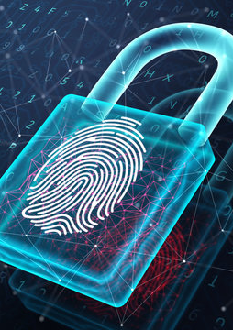
CRYPTOGRAPHY
Cryptography is a science of secure communication . It is study of techniques for secure communication Practice and Study of hiding information .
It provides Confidentiality , Integrity & Accuracy.
It is about constructing and analyzing protocol for secure communication

Slide 5
MESSAGE DIGEST AND DIGITAL SIGNATURE
Message Digest is a cryptographic hash function output representing a fixed-size hash value for a given data set.
Used for data integrity and authentication.

Slide 6
DIGITAL SIGNATURE
Digital signature is a mathematical technique used to validate the authenticity (originality) & integrity of a message, software , or digital document
A digital code (generated & authenticated by public key encryption ) which is attached to an electronically transmitted document to verify its contents & the sender identity. It’s created using mathematical techniques and cryptographic methods.
A digital signature offers far more inherent security according to hand writing signature.

Slide 7

DIGITAL CERTIFICATE
A file or password that has the proved authenticity of a device / server/ user.

Slide 8
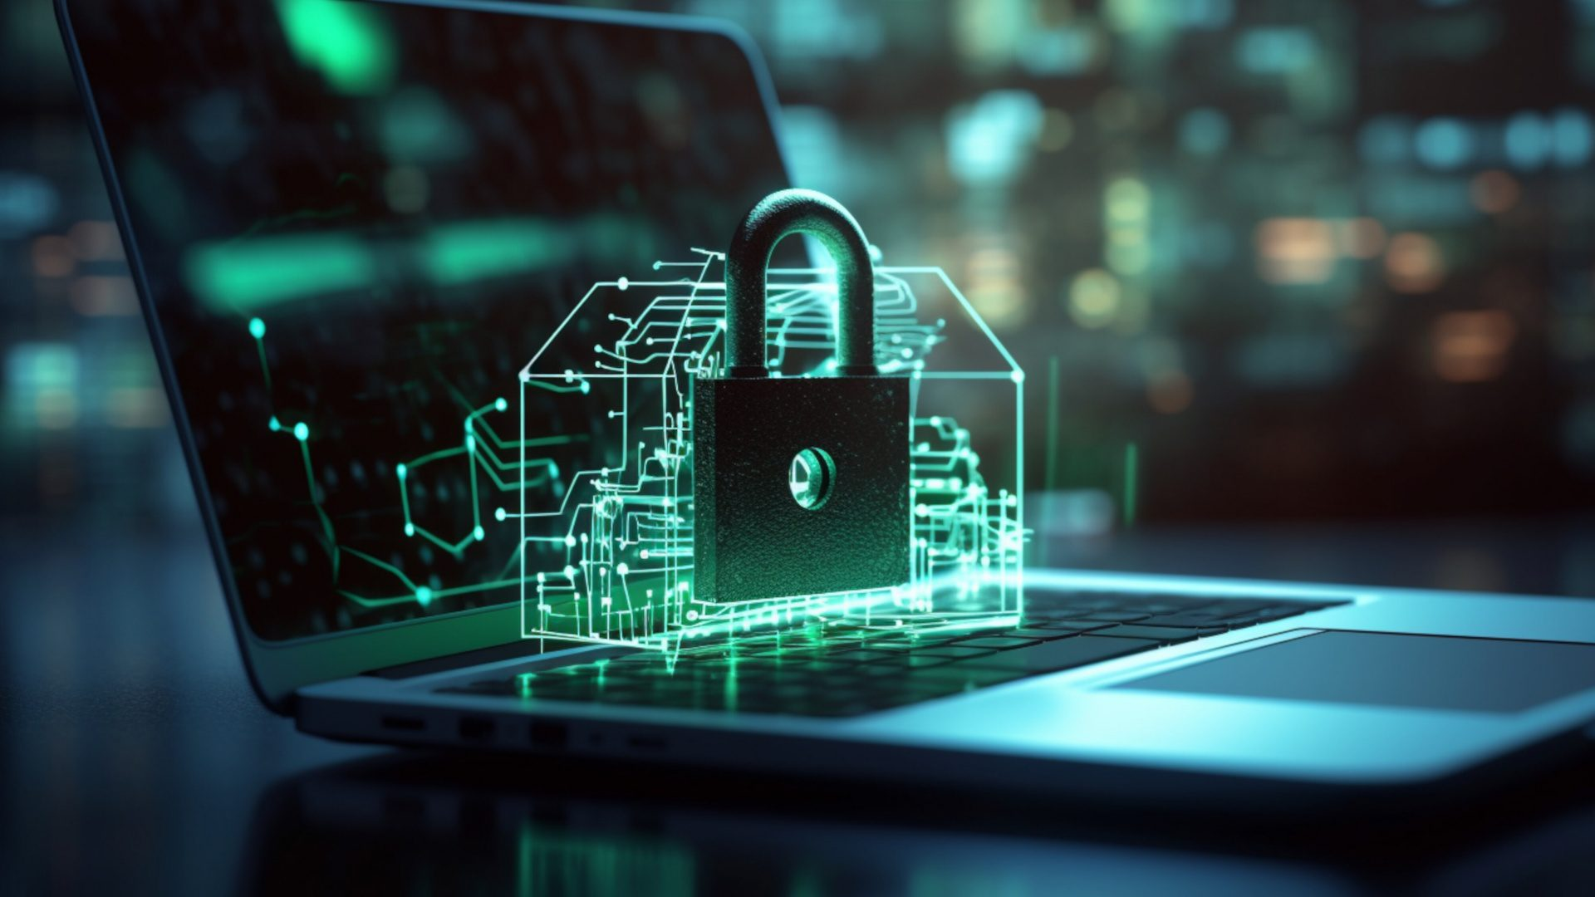
PKI
(Public key infrastructure)
It is the set of rule that are used to create manage distribute use store and revoke (del) digital certificate and manage public key encryption

Slide 9

GOALS OF S.M
PREVENTIVE
CORRECTIVE
COMPENSATING
ACT AS A DETERANT
DECTECTIVE

Slide 10
S.M TECHNOLOGIES
FIREWALL
Virus protection
BACKUP
USER IDENTIFICATION
Intrusion detection

Slide 11


